Slide 1

GlobeMediWatch
Empowering communities through medical camps and vital health services!
TEAM: 1. Neeraj Saini
Srijith Makam
Saurabh Srivatsava
Sri Charan Balakundhi

Slide 2

What We Do?
In many communities, access to basic health care services can be limited. GlobeMediWatch addresses this gap by organizing and managing health camps that provide essential health care services to those who need them the most, effectively bringing the clinic to the community.

Slide 3














Technologies Used

Slide 4
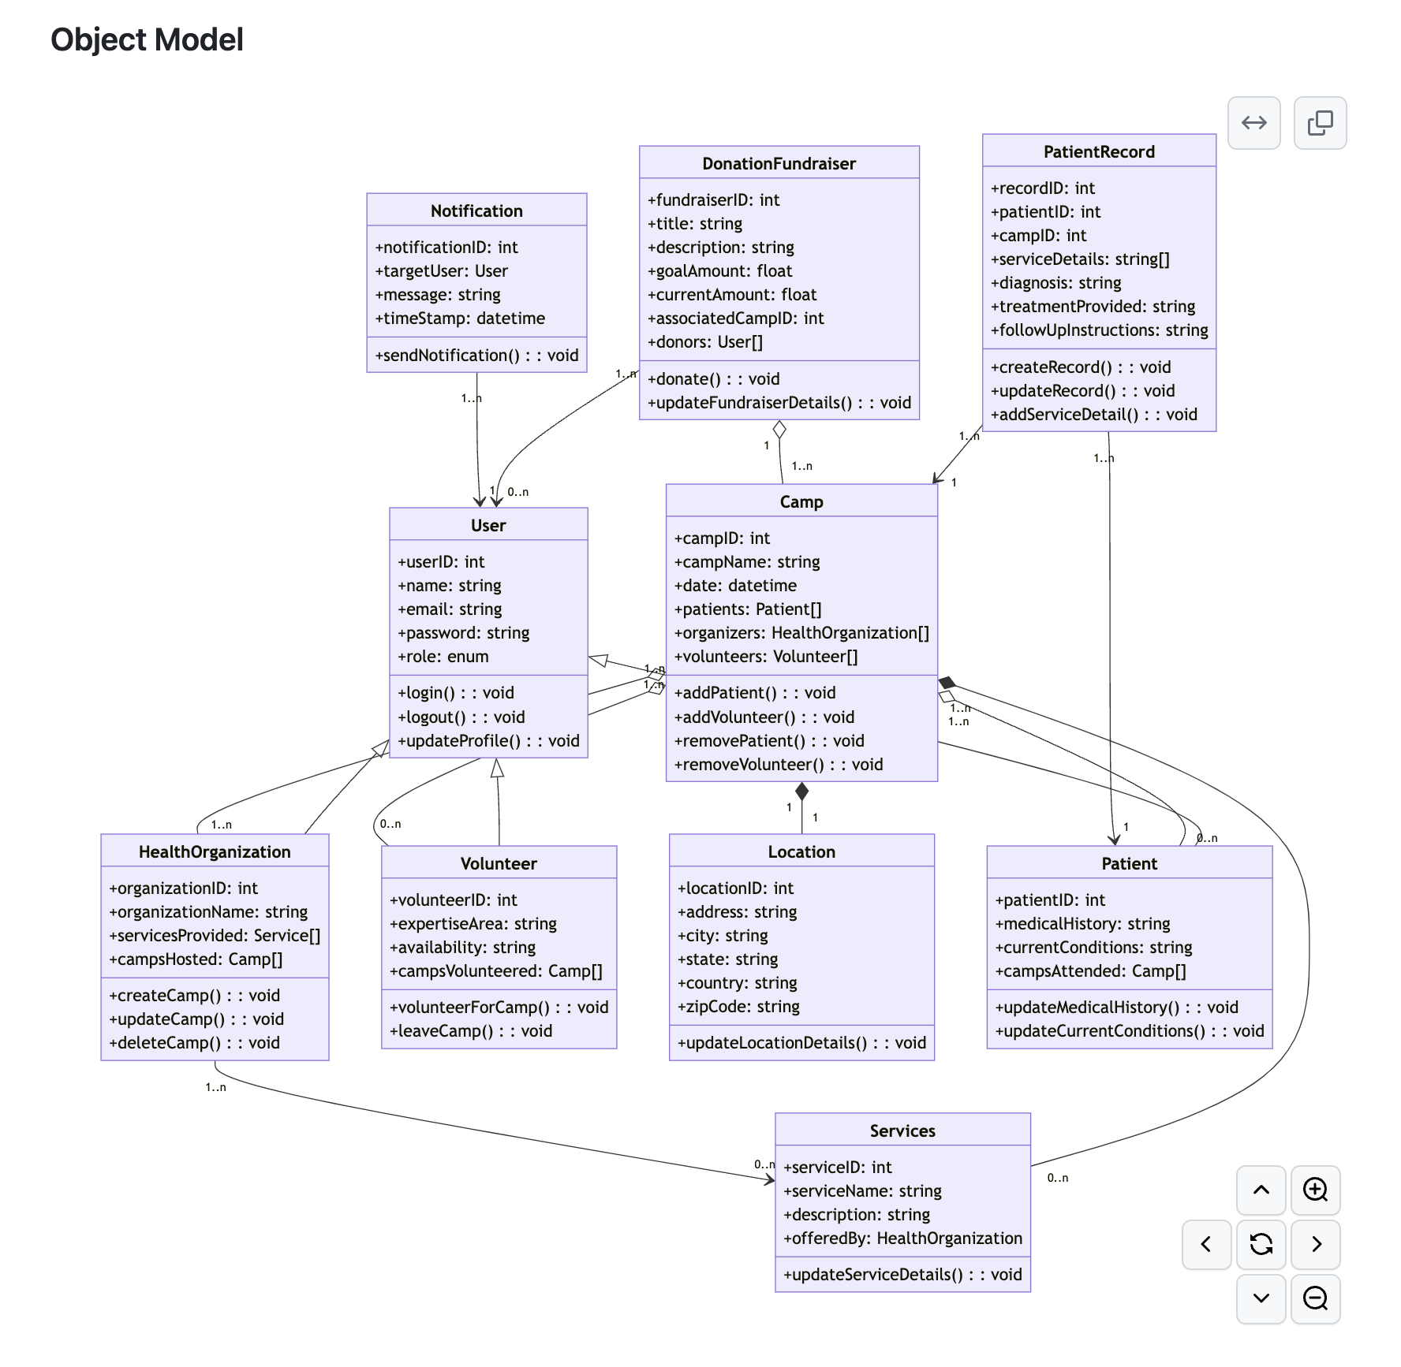

Slide 5
Features
Login/Sign-up
Donations/Fundraiser
Camp Management
Notifications and Alerts
Services

Slide 6

Screen Shots

Slide 7
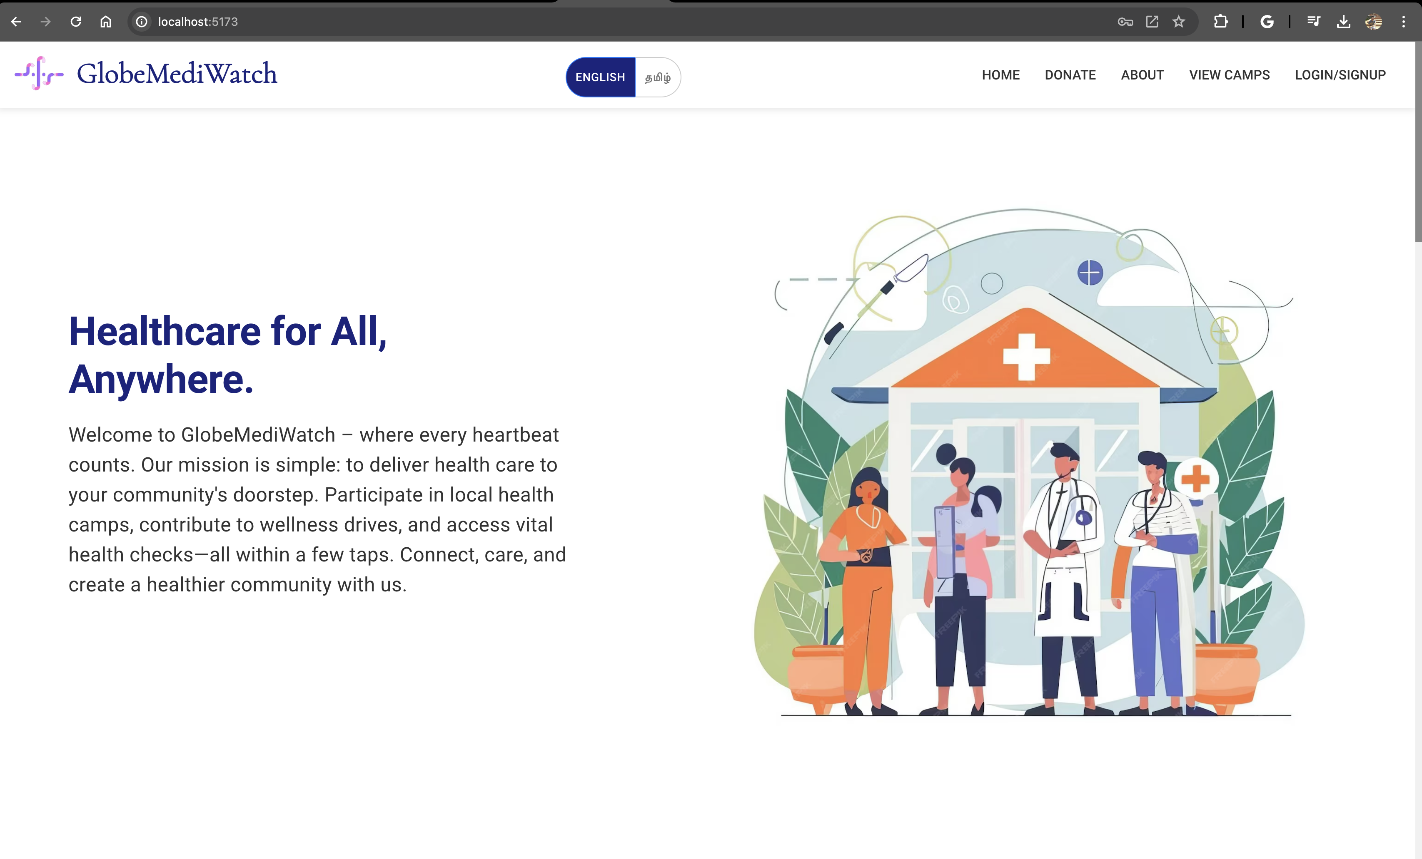
Home Page

Slide 8
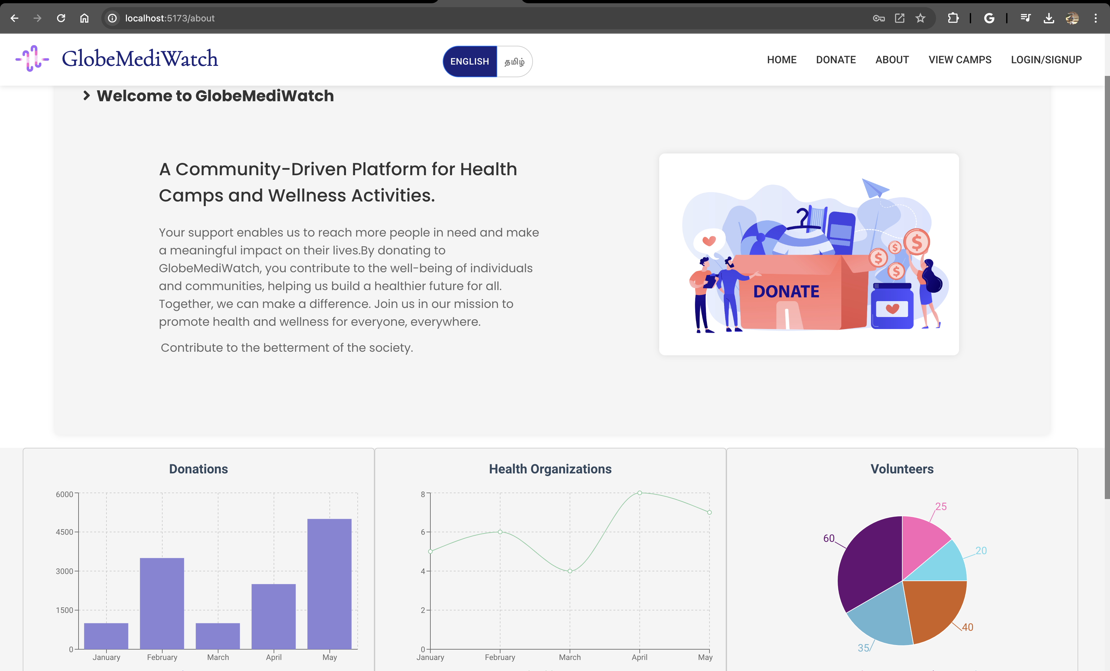
About

Slide 9
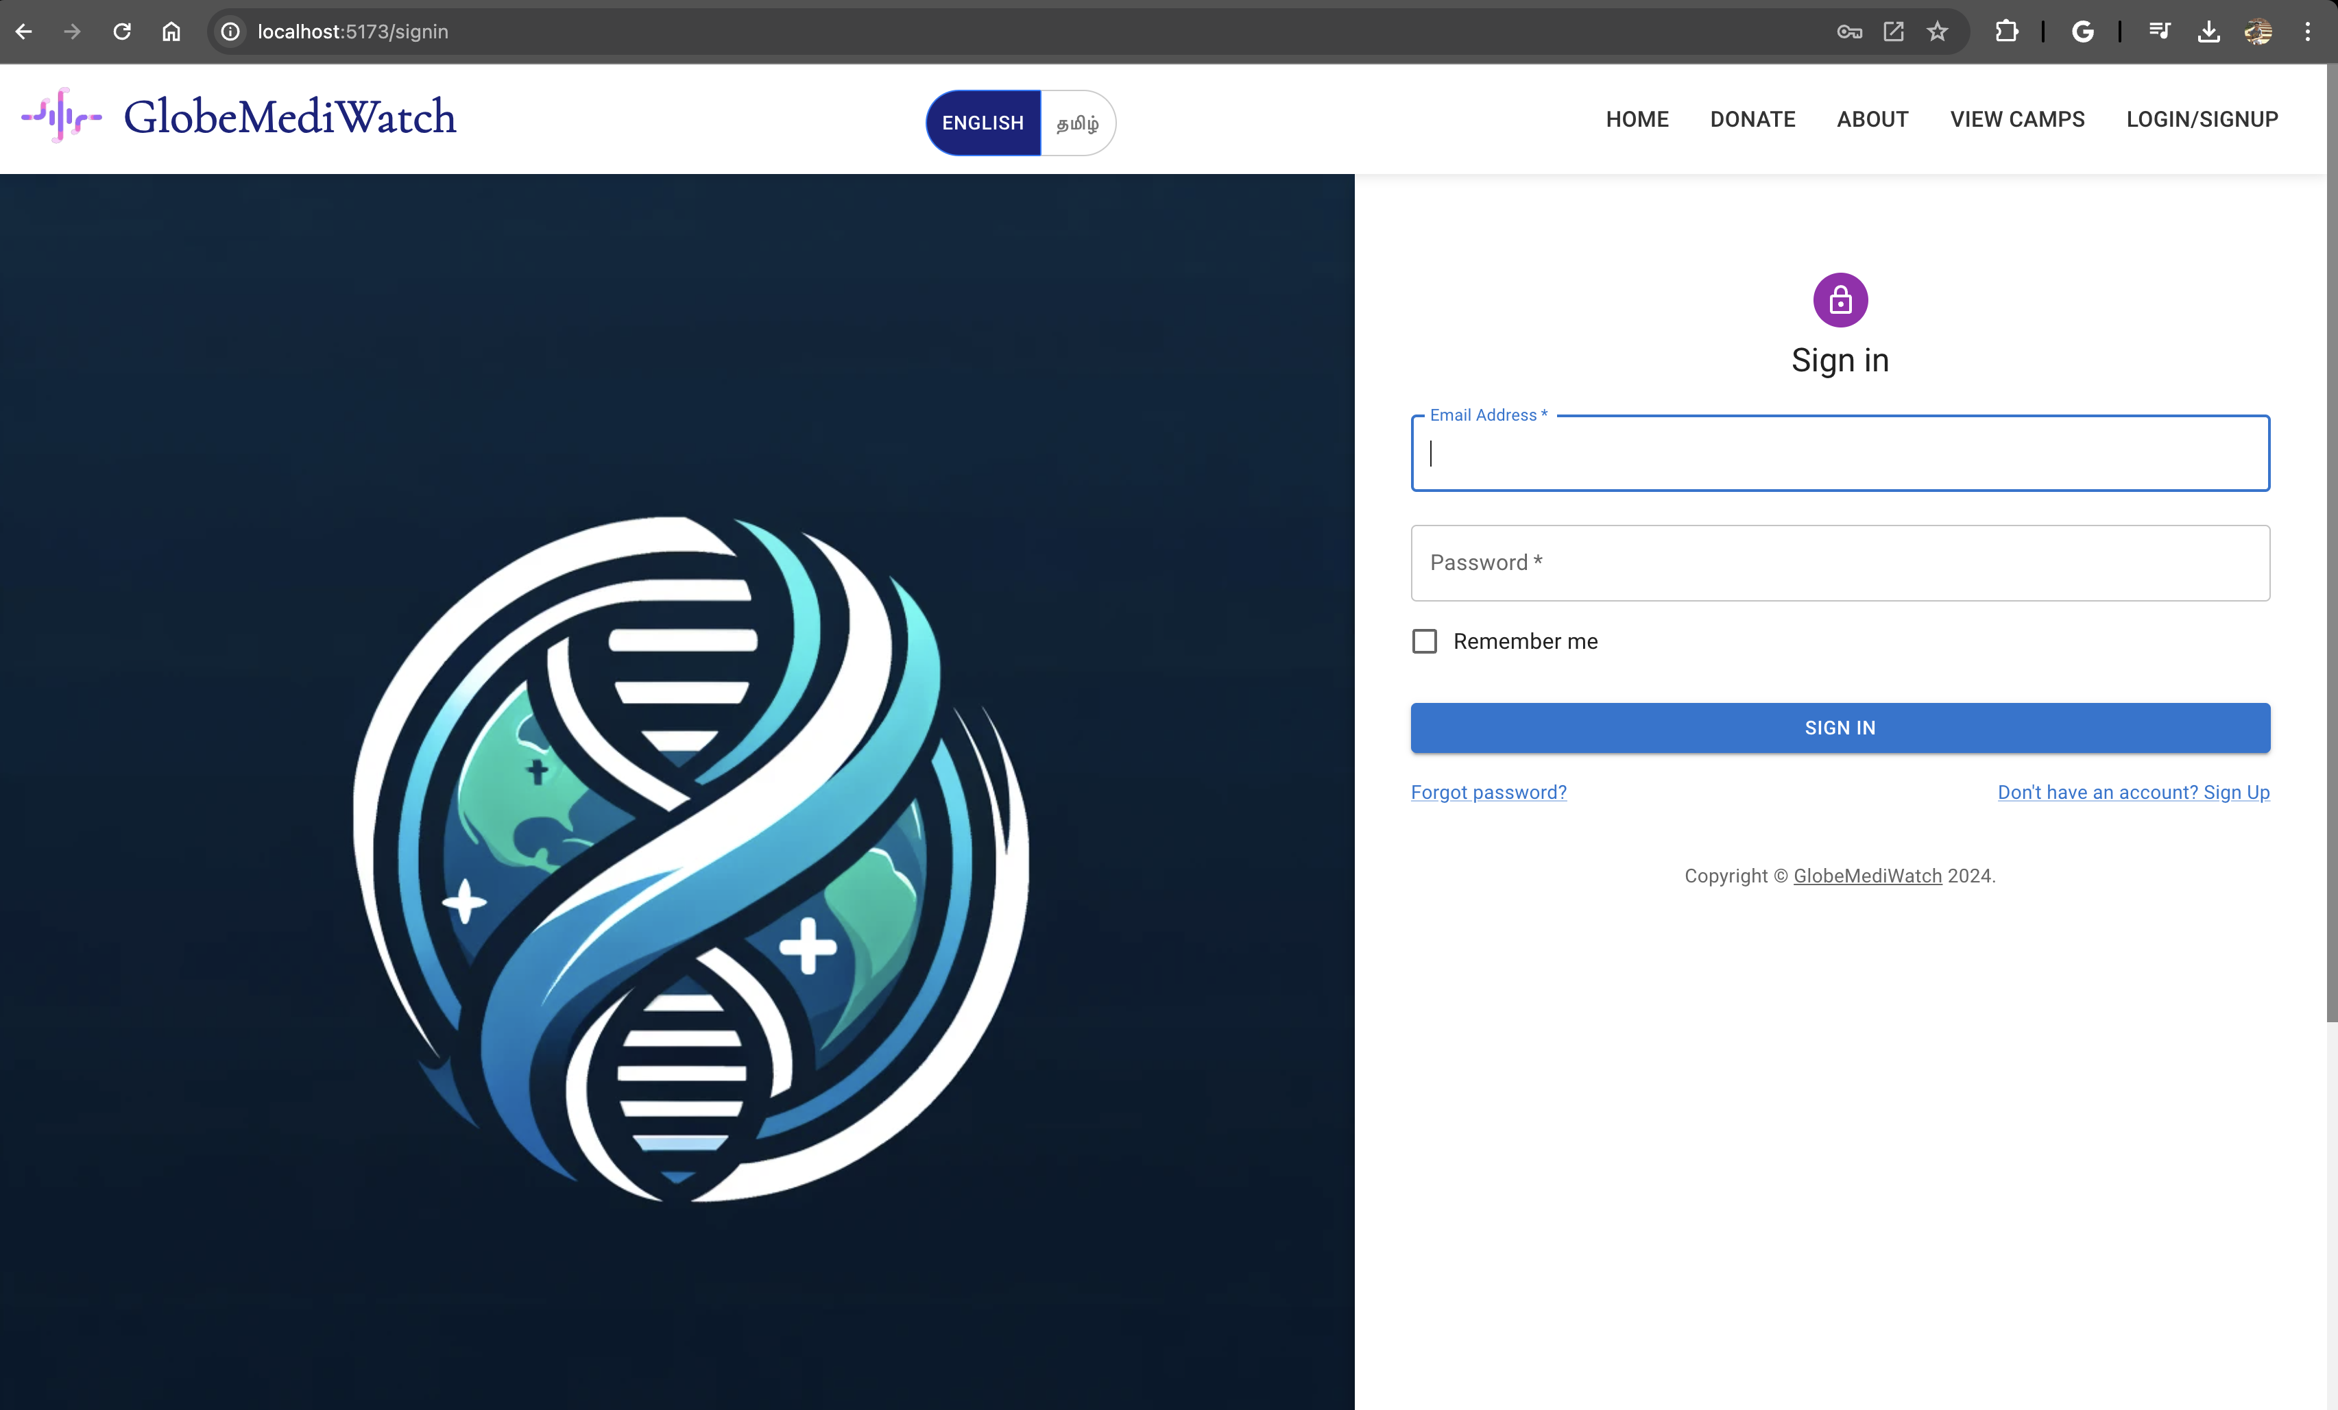
Login/Sign up

Slide 10
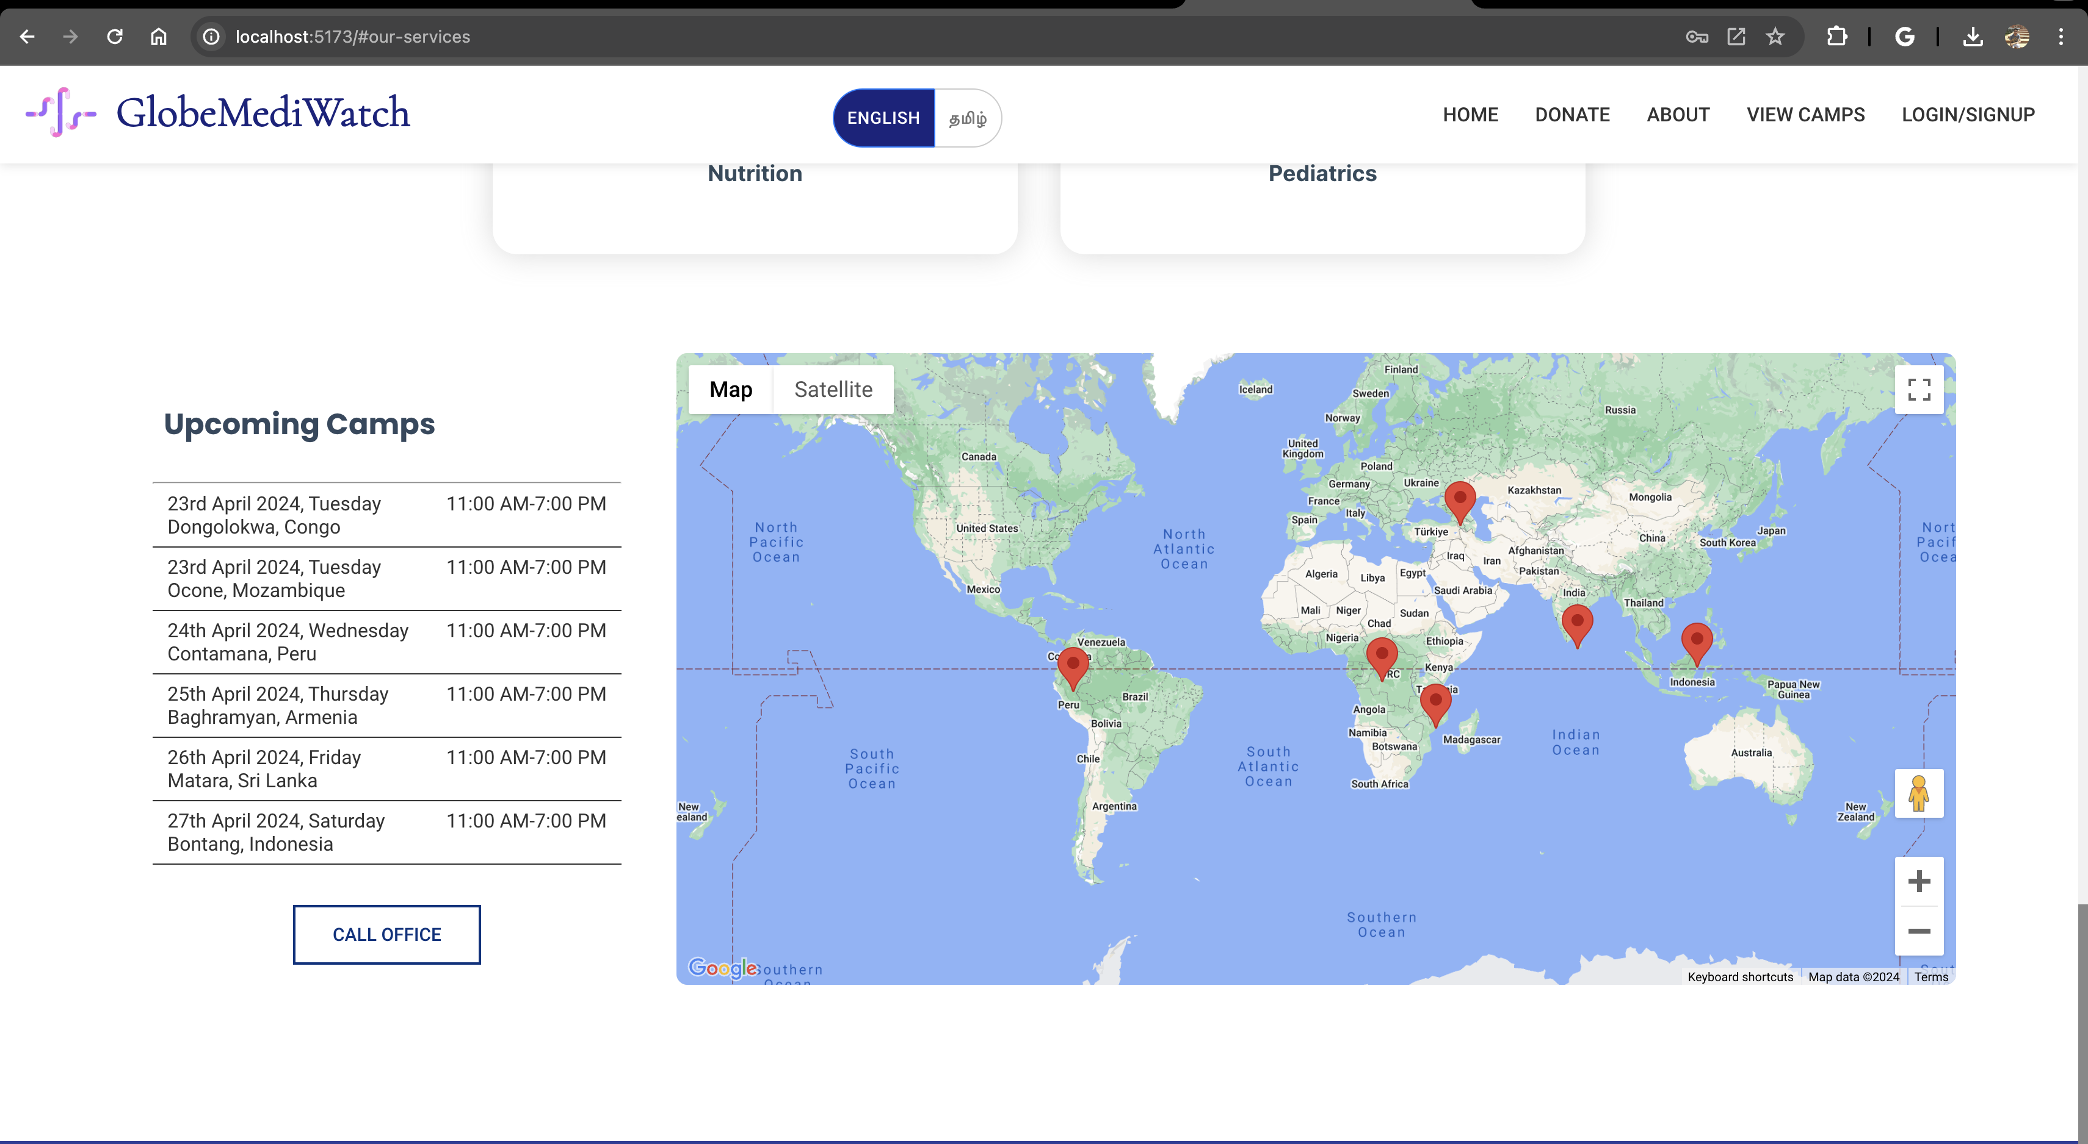
Upcoming Camps

Slide 11
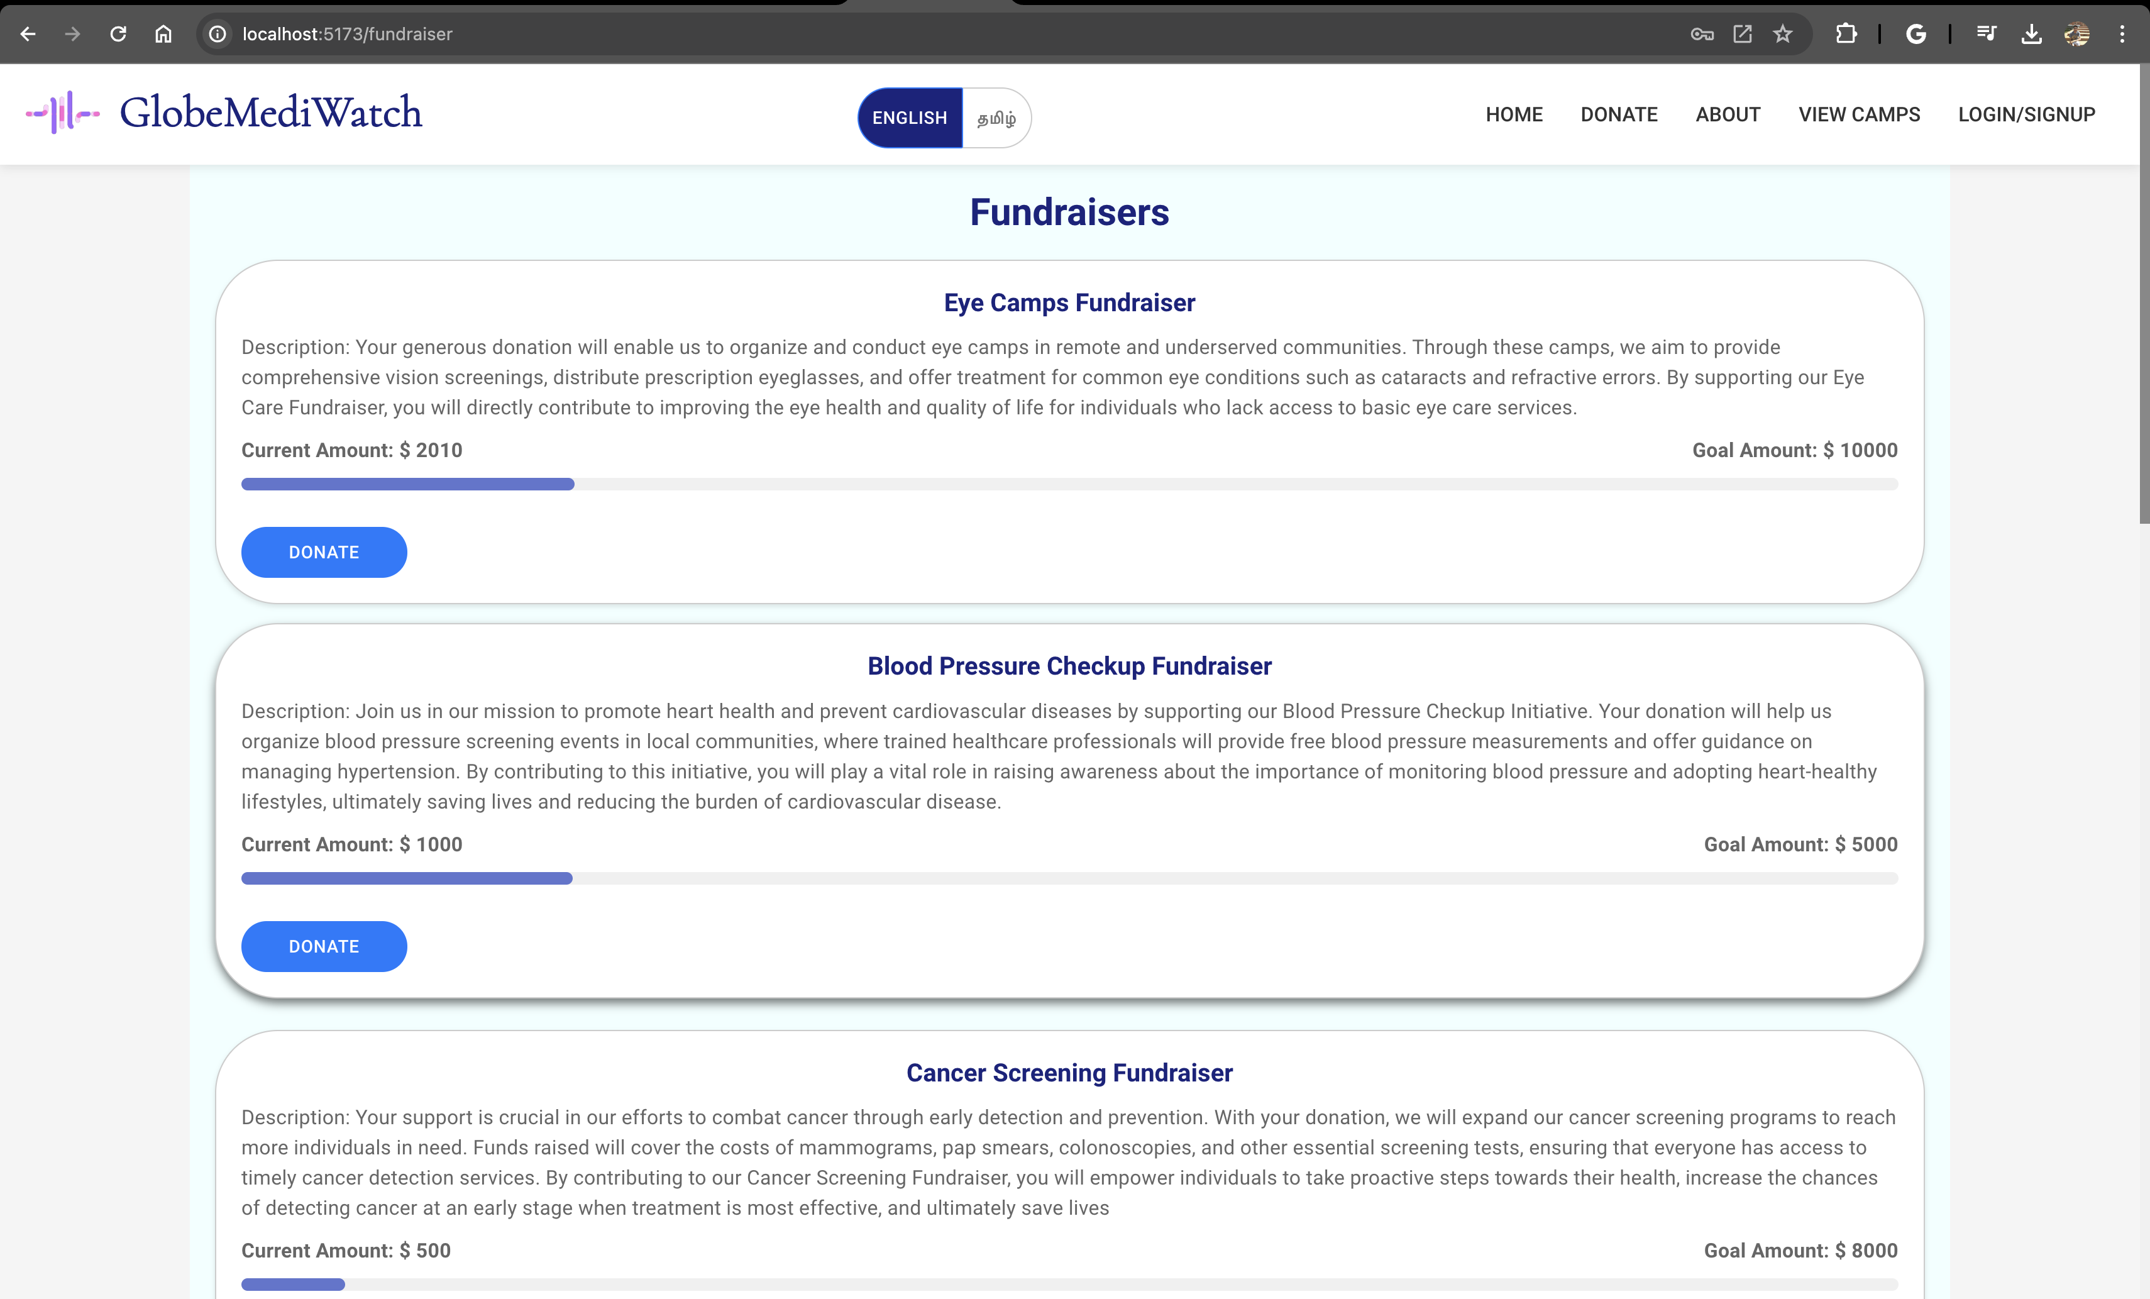
Donate

Slide 12
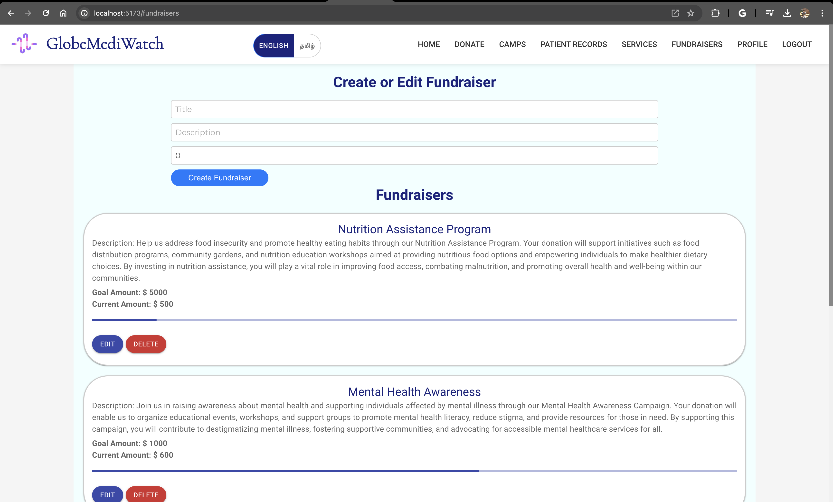
Edit and Manage Fundraisers

Slide 13
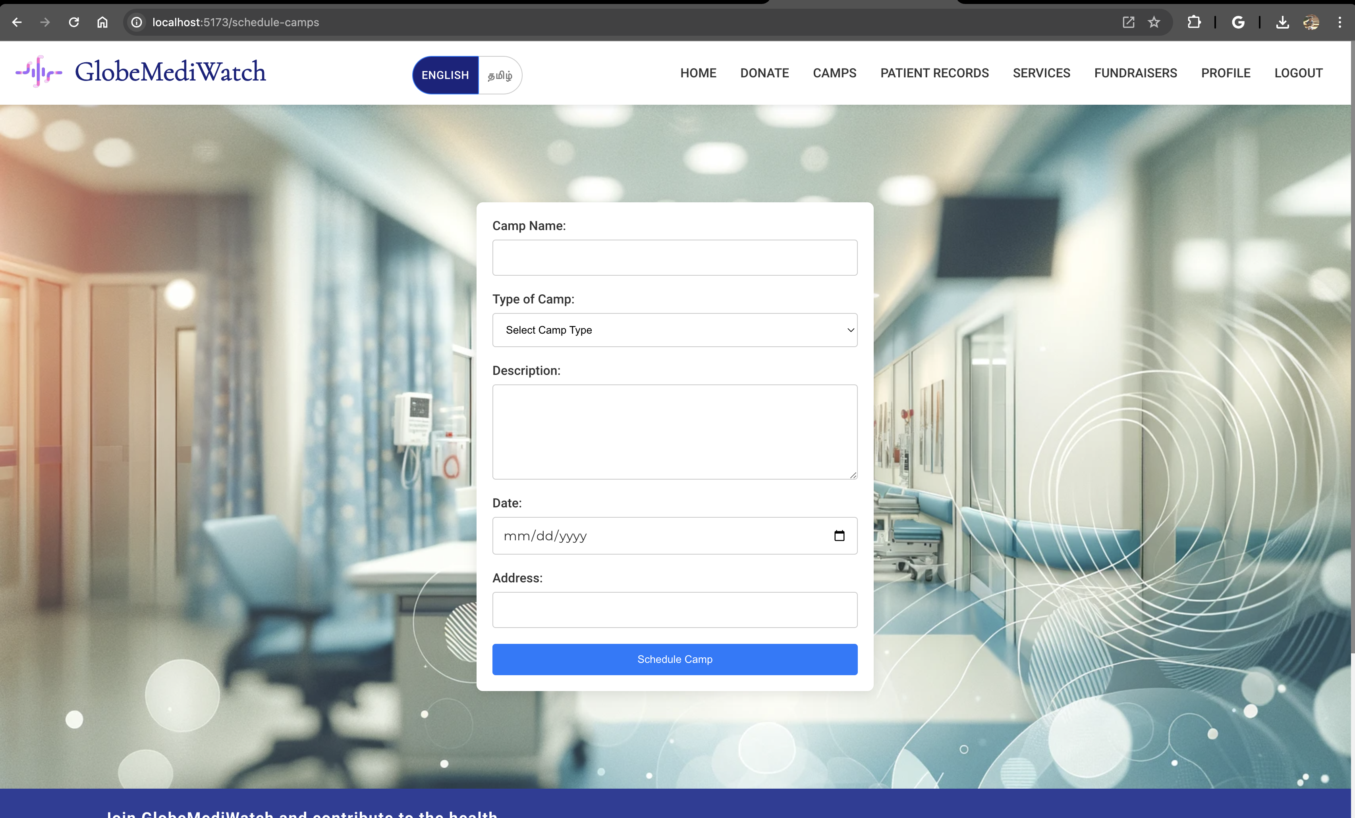
Schedule Camps

Slide 14
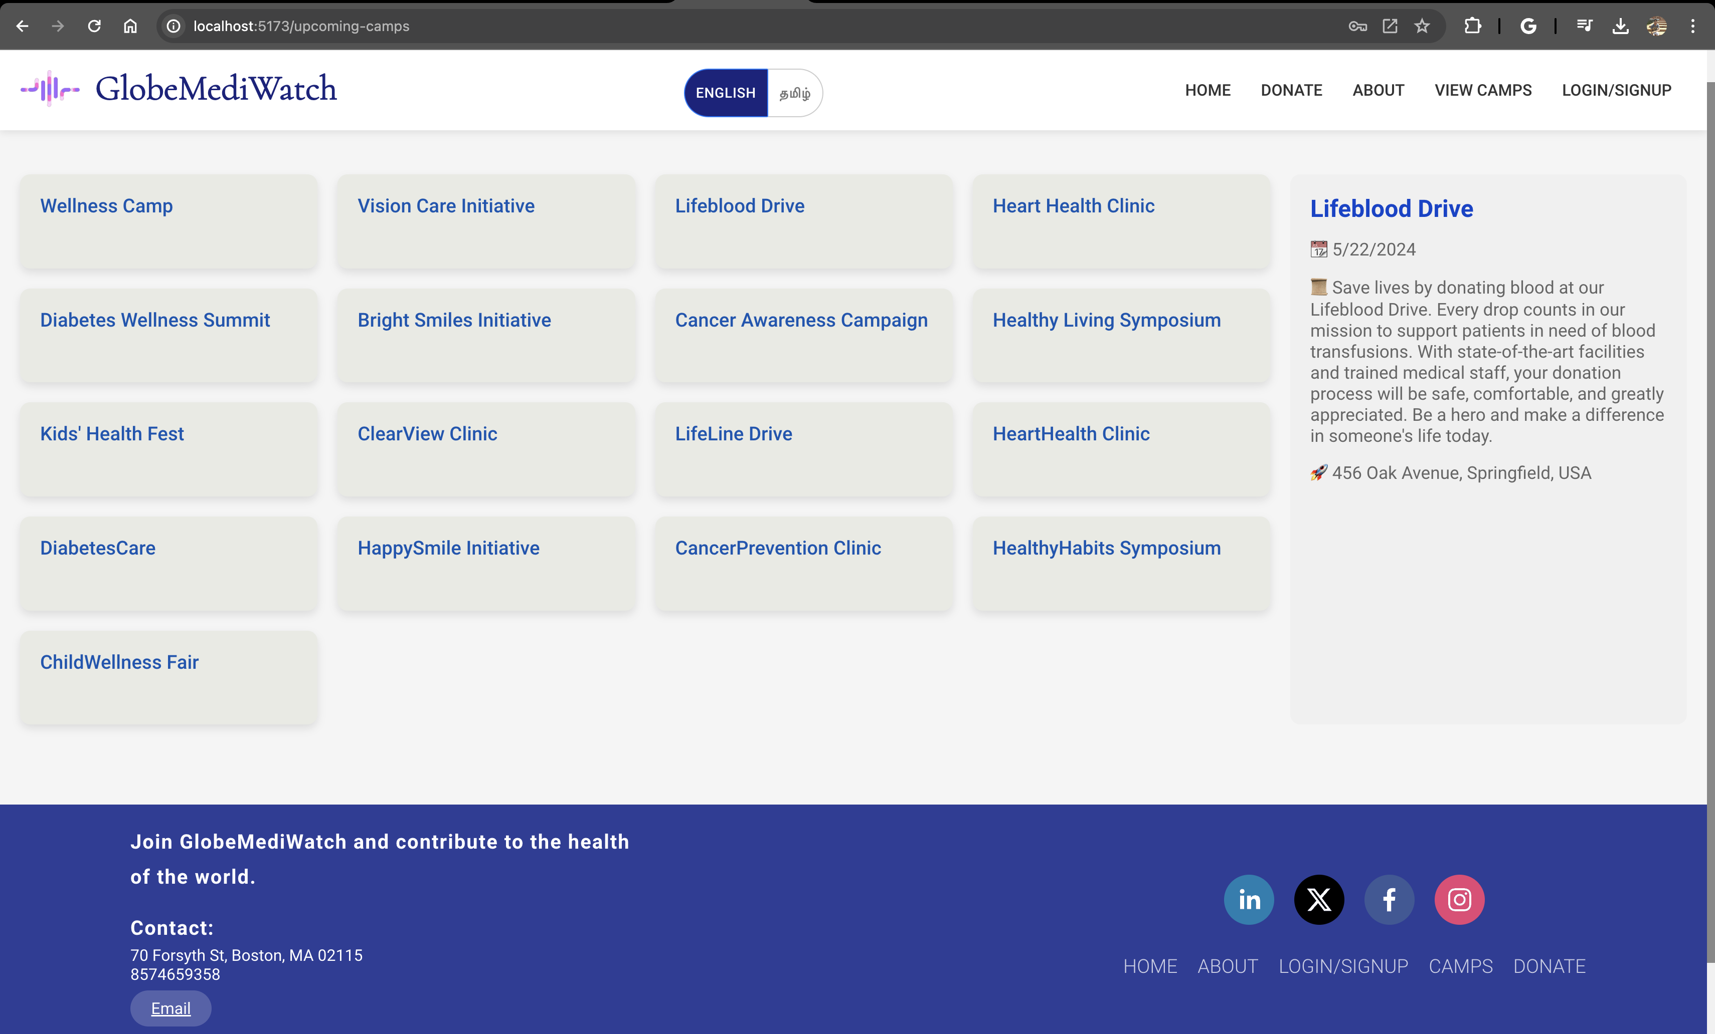
View Camps

Slide 15
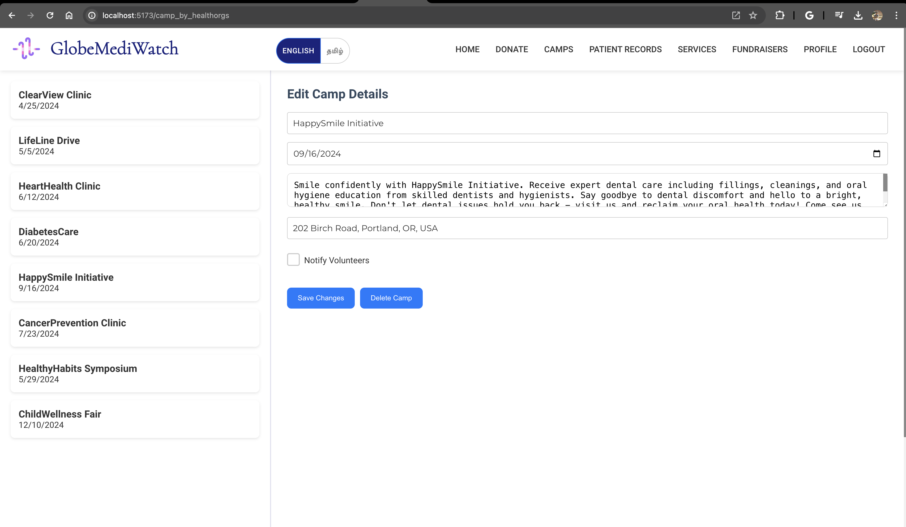
Edit Camps

Slide 16
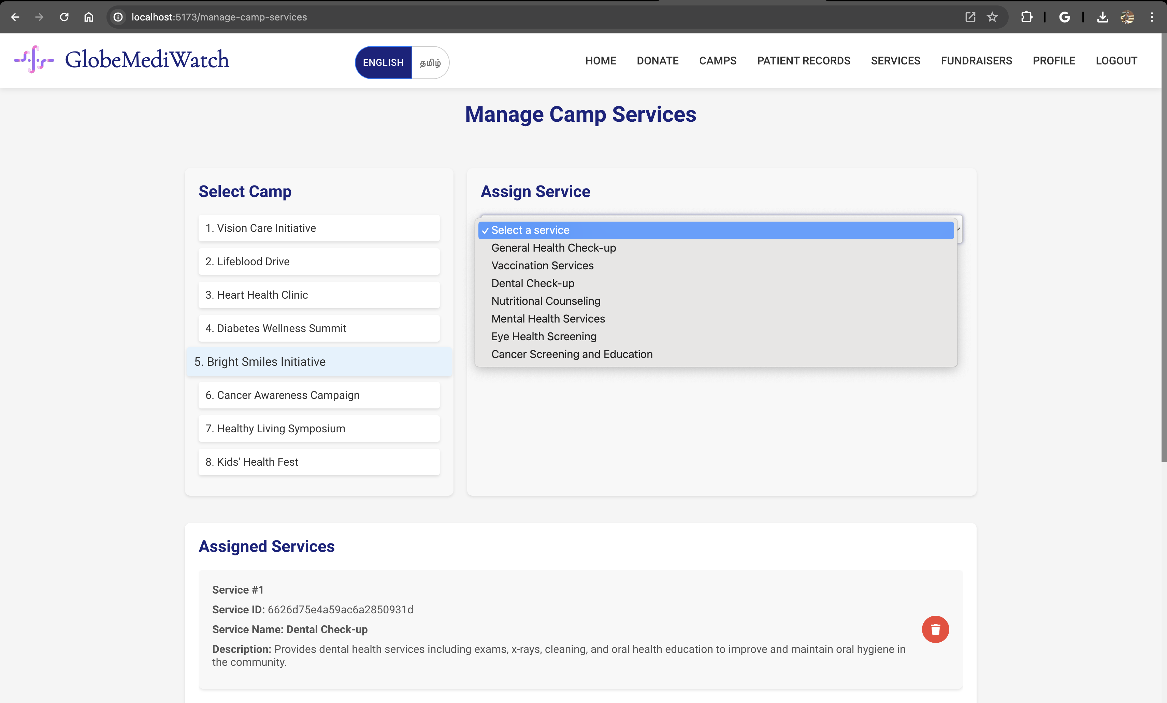
Manage Camp Services

Slide 17
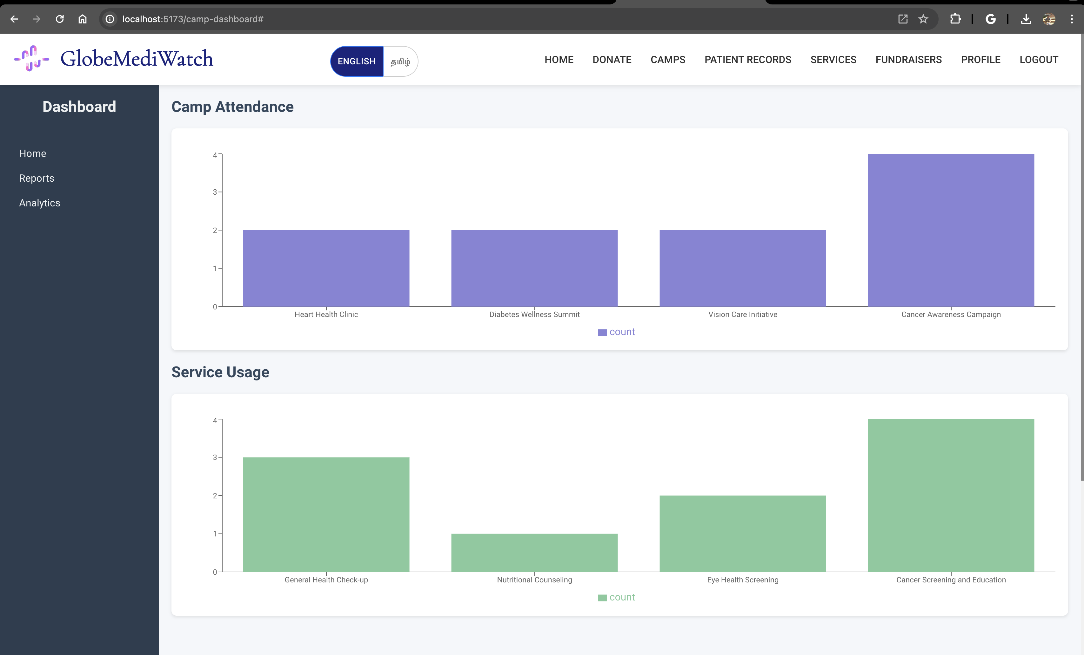
Camp Dashboard

Slide 18
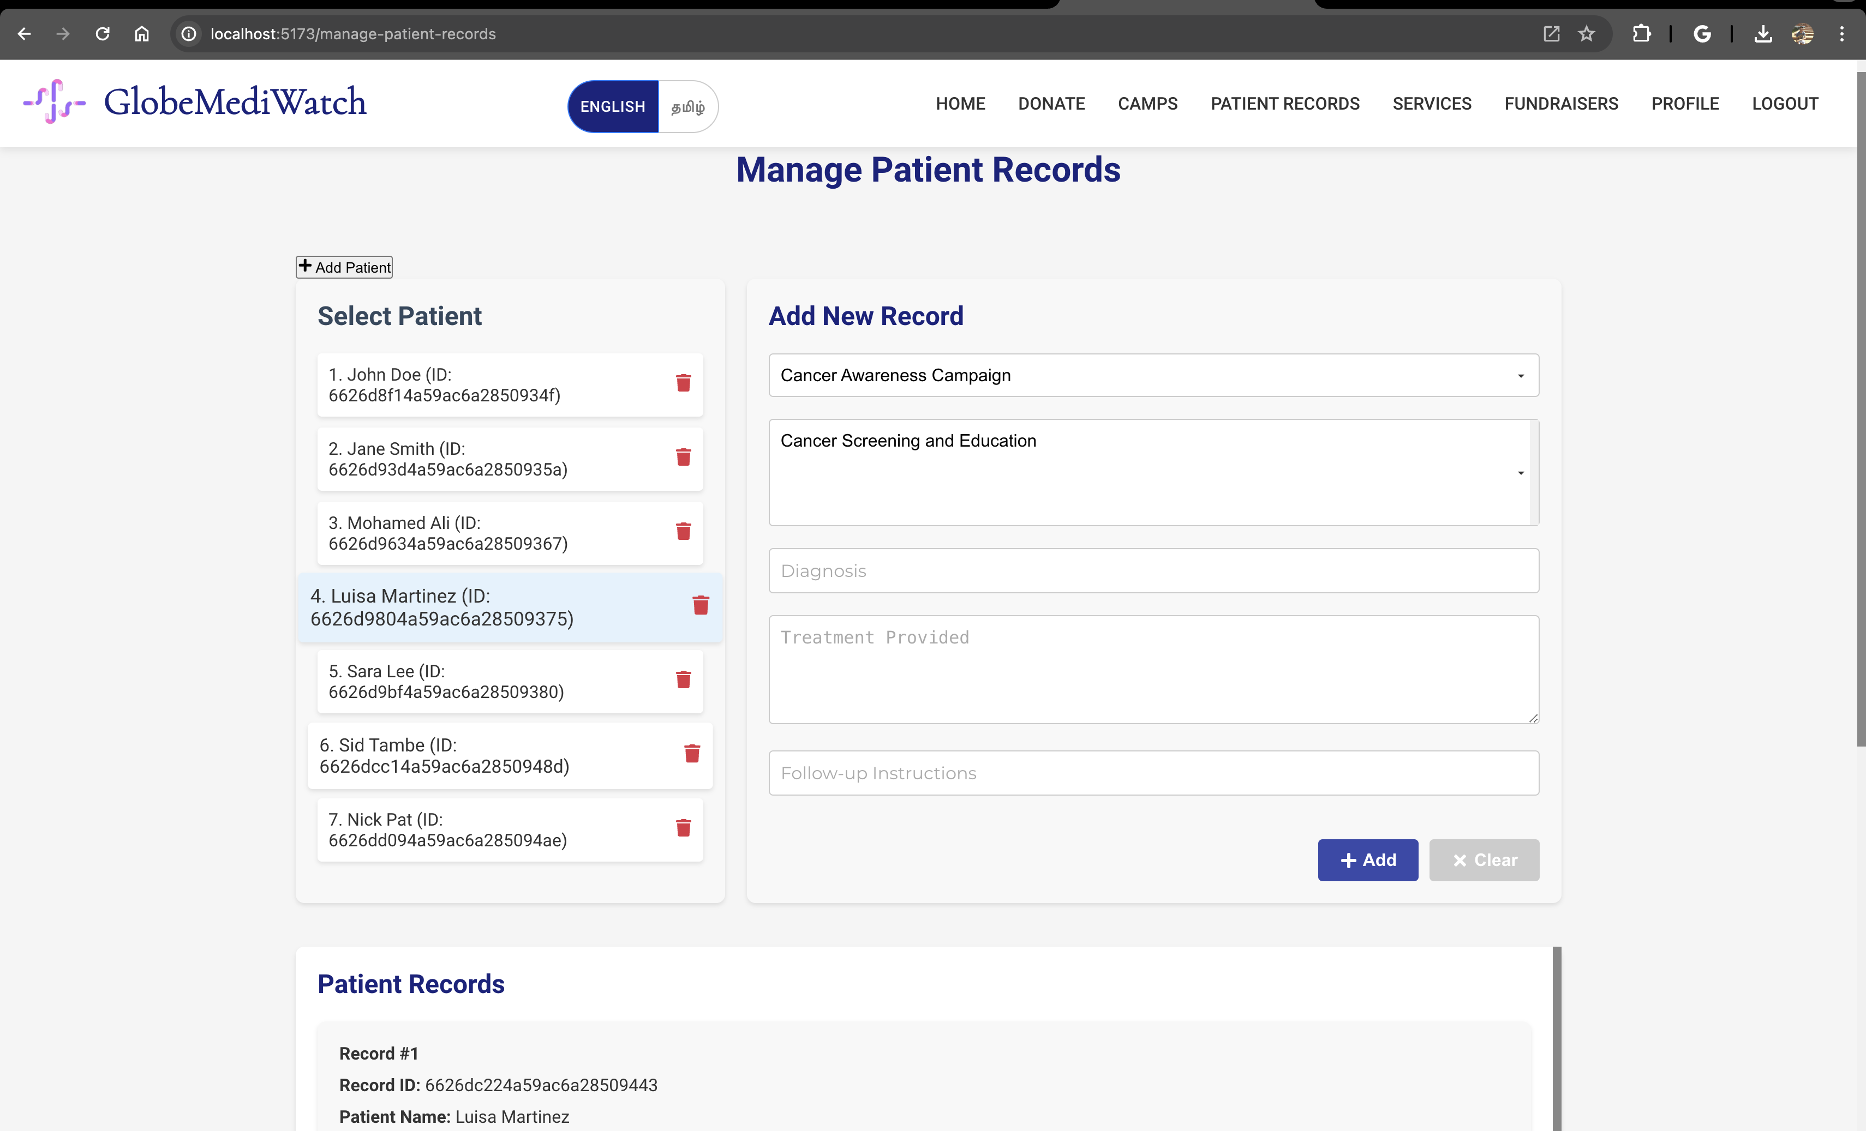
Manage Patient Record

Slide 19
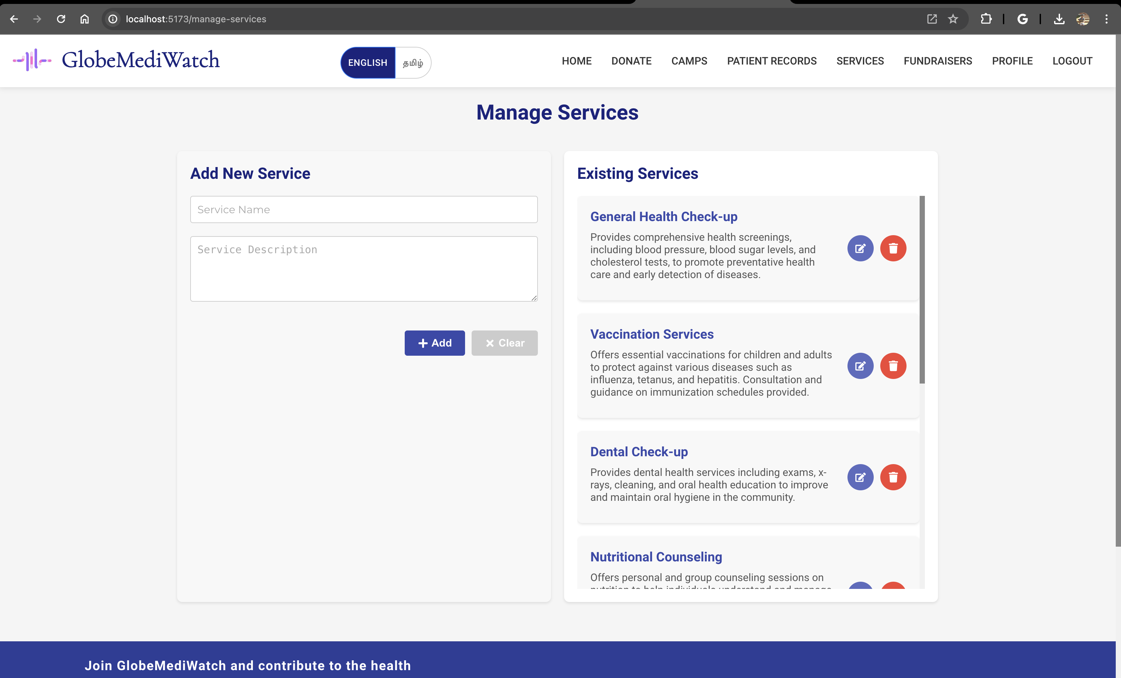
Manage Services

Slide 20

GitHub Repo : https://github.com/info-6150-spring-2024/final-project-globemediwatch

